Slide 1

Chris Woodruff
EF CORE
TURBO CHARGING FOR PERFORMANCE

Slide 2

Chris Woodruff
linkedin.com/in/chriswoodruff/
https://woodruff.dev
cwoodruff@live.com
https://bsky.app/profile/chriswoodruff.bsky.social

Slide 3
Agenda
Looking at EF Core for Perf
Looking at .NET for Perf
Looking at MSSQL for Perf
Questions & Answers

Slide 4
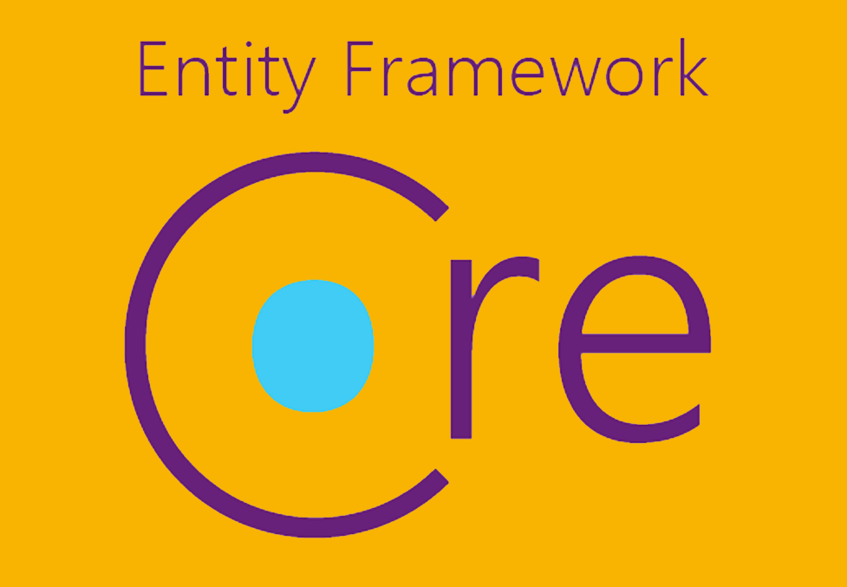
EF CORE

Slide 5
DBCONTEXT POOLING
DI Container
public class BlogsController : Controller
{
private BlogContext _context;
public BlogsController(BlogContext context)
{
_context = context;
}
public IActionResult Index()
{
return _context.Blogs.ToList();
}
}
Request: /blogs/index
Scope
BlogContext
Blogs
Controller
Request: /blogs/index
Scope
BlogContext
Blogs
Controller
Request: /blogs/index
Scope
BlogContext
Blogs
Controller

Slide 6
DBCONTEXT POOLING
DI Container
public class BlogsController : Controller
{
private BlogContext _context;
public BlogsController(BlogContext context)
{
_context = context;
}
public IActionResult Index()
{
return _context.Blogs.ToList();
}
}
Request: /blogs/index
Context Pool
Scope
BlogContext
BlogContext
Scope
Blogs
Controller
BlogContext
BlogContext
BlogContext
Request: /blogs/index
BlogContext
BlogContext
Blogs
Controller
Scope
Request: /blogs/index
Scope
BlogContext
Blogs
Controller

Slide 7
DBCONTEXT POOLING
public void ConfigureServices(IServiceCollection services)
{
services.AddDbContextPool<ChinookContext>(c => c.UseSqlServer(ConnectionString));
}

Slide 8
DBCONTEXT POOLING
No Pooling
Total context creations: 64637
Requests per second: 6395
Using Pooling
Total context creations: 32
Requests per second: 15714
Notes:
Lambda and then delegate

Slide 9
COMPILED QUERIES
var explicitQuery = EF.CompileQuery((ChinookContext context, int id)
=> _context.Albums.FirstOrDefault(a => a.Id == id));
var compiledExplicitQuery =
EF.CompileAsyncQuery((ChinookContext context, int id)
=> context.Albums.FirstOrDefault(a => a.Id == id));
Notes:
Lambda and then delegate

Slide 10
COMPILED MODELS
dotnet ef dbcontext optimize --output-dir ChinookModels --namespace ChinookModels
protected override void OnConfiguring(DbContextOptionsBuilder optionsBuilder)
=> optionsBuilder
.UseModel(ChinookModels.AlbumsContextModel.Instance)
.UseSqServer(“<ConnectionString>");
Things to remember”
Global Query Filters not supported
Lazy-loading and Change-Tracking proxies not supported
You must regenerate the compiled modal each time the code
for the dbcontext changes

Slide 11
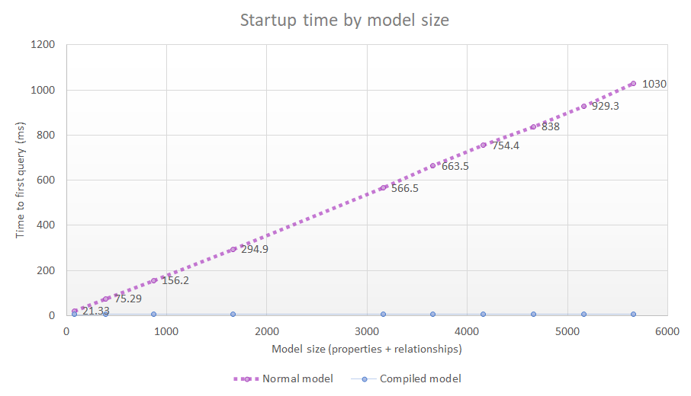
COMPILED MODELS

Slide 12
FROMSQL
var city = "Redmond";
using (var context = CreateContext())
{
context.Customers.FromSql($@“
SELECT *
FROM Customers
WHERE City = {city}");
}
SELECT *
FROM Customers
WHERE City = @p0
SELECT *
FROM Customers
WHERE City = ‘Redmond’

Slide 13
Split Queries
using var context = new BloggingContext();
// Fetch Blogs and their Posts using split queries
var blogs = await context.Blogs
.Include(b => b.Posts)
.AsSplitQuery() // Splits into multiple SQL queries
.ToListAsync();
foreach (var blog in blogs)
{
Console.WriteLine($"Blog: {blog.Name}");
foreach (var post in blog.Posts)
{
Console.WriteLine($" Post: {post.Title}");
}
}
Notes:
Key Points for the Slide:
AsSplitQuery(): Forces EF Core to execute multiple simpler SQL queries instead of a single large one.
Improves Performance: Reduces memory pressure for large datasets.
Control Data Loading: Useful for scenarios with complex relationships.

Slide 14
Split Queries
SELECT [b].[BlogId], [b].[Name]
FROM [Blogs] AS [b]
SELECT [p].[PostId], [p].[Title], [p].[BlogId]
FROM [Posts] AS [p]
WHERE EXISTS (
SELECT 1
FROM [Blogs] AS [b]
WHERE [b].[BlogId] = [p].[BlogId]
)
Notes:
Key Points for the Slide:
AsSplitQuery(): Forces EF Core to execute multiple simpler SQL queries instead of a single large one.
Improves Performance: Reduces memory pressure for large datasets.
Control Data Loading: Useful for scenarios with complex relationships.

Slide 15
Batching Updates and Inserts
using var context = new AppDbContext();
// Insert multiple users in a single batch
var newUsers = new List<User>
{
new User { Name = "Alice", Email = "alice@example.com" },
new User { Name = "Bob", Email = "bob@example.com" }
};
context.Users.AddRange(newUsers);
// Update multiple users in a single batch
var existingUsers = await context.Users.Where(u => u.IsActive).ToListAsync();
foreach (var user in existingUsers)
{
user.LastActive = DateTime.UtcNow;
}
// Save all changes in a single database transaction
await context.SaveChangesAsync();
Notes:
Key Points for the Slide:
Batch Inserts: Use AddRange to add multiple entities efficiently.
Batch Updates: Modify entities in-memory and save them all at once.
Single Transaction: SaveChangesAsync groups operations into a single transaction, minimizing database round trips.

Slide 16
using var context = new BloggingContext();
// Fetch Blogs without related data
var blogs = await context.Blogs.ToListAsync();
foreach (var blog in blogs)
{
Console.WriteLine($"Blog: {blog.Name}");
// Explicitly load related Posts for each Blog
await context.Entry(blog)
.Collection(b => b.Posts)
.LoadAsync();
foreach (var post in blog.Posts)
{
Console.WriteLine($" Post: {post.Title}");
}
}
Explicit
Includes
Notes:
Key Points for the Slide:
Precise Control: Explicit loading ensures only the required related data is fetched.
Efficient: Avoids the overhead of eager loading or hidden lazy-loading queries.
Use Case: Ideal for loading related data dynamically, one entity at a time.

Slide 17
QUERY PROJECTION
SELECT *
FROM [dbo].[Employee]
SELECT [Id]
,[LastName]
,[FirstName]
,[Title]
,[ReportsTo]
,[BirthDate]
,[HireDate]
,[Address]
,[City]
,[State]
,[Country]
,[PostalCode]
,[Phone]
,[Fax]
,[Email]
FROM [dbo].[Employee]

Slide 18
QUERY PROJECTION
SELECT *
FROM [dbo].[Employee]
SELECT [Id]
,[LastName]
,[FirstName]
,[Title]
,[Address]
,[City]
,[State]
,[Country]
,[PostalCode]
,[Phone]
,[Fax]
,[Email]
FROM [dbo].[Employee]

Slide 19
QUERY PROJECTION
from e in Employees select e
from e in Employees select new { e.Id, e.LastName, e.FirstName, FullName = e.FirstName + " " + e.LastName, e.Title, e.Address, e.City, e.State, e.Country, e.PostalCode, e.Phone, e.Fax, e.Email }

Slide 20
NO TRACKING
var albums = db.Albums .AsNoTracking() .ToList();
Notes:
Removes Identity Resolution also

Slide 21
NO TRACKING
protected override void OnConfiguring(DbContextOptionsBuilder optionsBuilder)
{
optionsBuilder
.UseSqlServer(ConnectionString)
.UseQueryTrackingBehavior(QueryTrackingBehavior.NoTracking);
}

Slide 22
IDENTITY RESOLUTION
var albums = db.Albums .AsNoTrackingWithIdentityResolution() .ToList();
Notes:
AsNoTrackingWithIdentityResolution() to not track entities but still perform identity resolution so you won’t have duplicate instances.

Slide 23
STORED PROCS
public Artist GetById(int id)
{
var artists = context.Artists
.FromSql($“dbo.sproc_GetArtistDetails {id}")
.ToList();
return artists.FirstOrDefault();
}

Slide 24
GLOBAL QUERY FILTERS
modelBuilder.Entity<Album>().HasQueryFilter(p => !p.IsOutOfStock);
var albums = context.Albums.Include(a => a.Tracks)
.Where(a => a.ArtistId == id);
// Hide invoices older than 14 years
modelBuilder.Entity<Invoice>().
.HasQueryFilter(i => i.InvoiceDate > DateTime.Now.AddYears(-14));
var invoices = context.Invoices.Include(i => i.InvoiceLines)
.Where(i => i.CustomerId == id);

Slide 25

.NET

Slide 26
CODE BETTER
private readonly ChinookDbContext _context;
var albumsData = _context.Albums;
for (int i = 0; i < albumsData.Count(); i++)
{
_Response.Items.Add(new Models.Items
{
Name = albumsData.ToList()[i].Name,
....
Created = (DateTime) albumsData.ToList()[i].Created,
Updated = (DateTime) albumsData.ToList()[i].Updated
});
}

Slide 27
CODE BETTER
private readonly ChinookDbContext _context;
var albumsData = _context.Albums.ToList();
foreach (var album in albumsData)
{
_Response.Albums.Add(new Models.Items
{
Name = album.Name,
....
Created = (DateTime)album.Created,
Updated = (DateTime) album.Updated
});
}
Notes:
Optimized for Enumerables
EF Core Collections: EF Core often returns data as IEnumerable<T> or IQueryable<T>. A foreach loop works seamlessly with these types because it uses the enumerator directly.
for Loop Limitation: A for loop requires a Count property or indexer, which might force materialization (e.g., calling .ToList()), introducing unnecessary overhead and potentially triggering multiple database queries.
Deferred Execution in LINQ
EF Core queries (e.g., IQueryable) use deferred execution, meaning the data is only fetched when the collection is enumerated. A foreach loop triggers enumeration naturally.
In contrast, using a for loop often requires materializing the collection into memory (e.g., calling .ToList()), which can consume more memory unnecessarily.
Performance Considerations
In terms of raw performance:
foreach and for have similar performance for fully materialized collections (e.g., lists, arrays).
When iterating over an IQueryable or deferred query:
foreach works seamlessly and minimizes memory usage by streaming results.
A for loop often requires materializing the data first, which can increase memory usage and impact performance.

Slide 28

Other Things to Remember

Slide 29
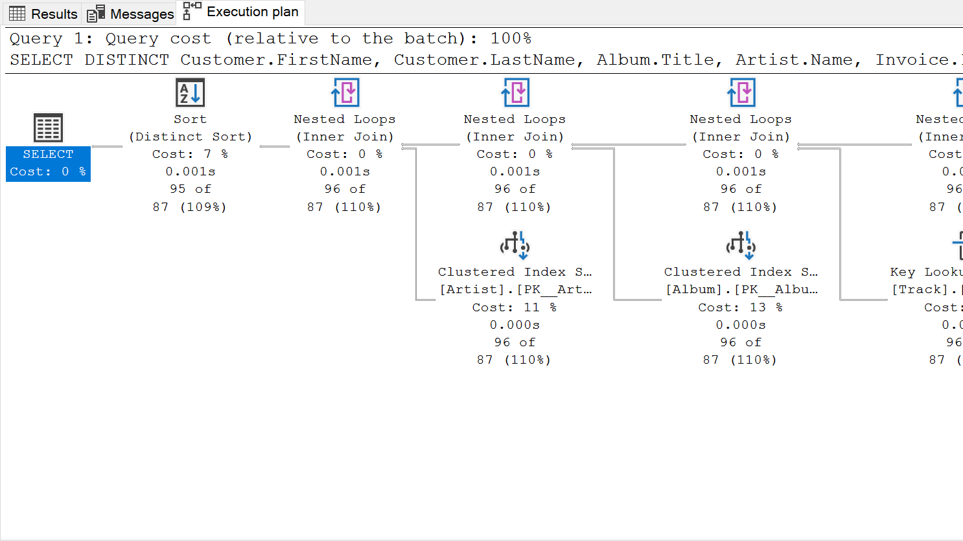
understand query Plans

Slide 30
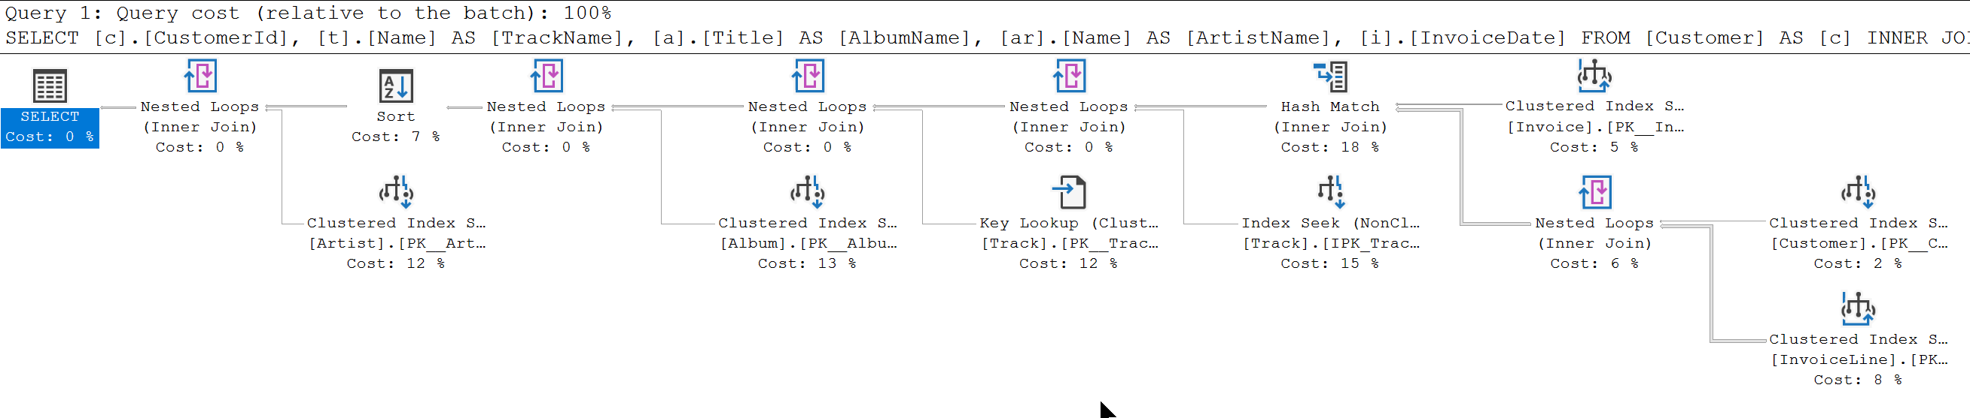
SELECT c.CustomerId, t.Name AS TrackName, a.Title AS AlbumName, ar.Name AS ArtistName, i.InvoiceDate
FROM Customer AS c
INNER JOIN Invoice AS i ON c.CustomerId = i.CustomerId
INNER JOIN InvoiceLine AS il ON i.InvoiceId = il.InvoiceId
INNER JOIN Track AS t ON il.TrackId = t.TrackId
INNER JOIN Album AS a ON t.AlbumId = a.AlbumId
INNER JOIN Artist AS ar ON a.ArtistId = ar.ArtistId
WHERE c.CustomerId = 2
ORDER BY AlbumName

Slide 31
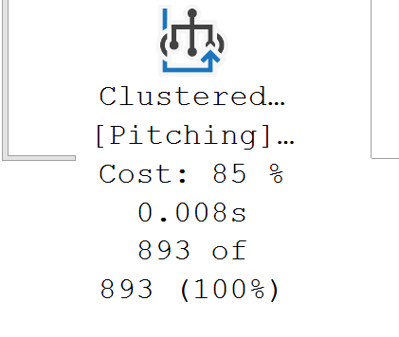
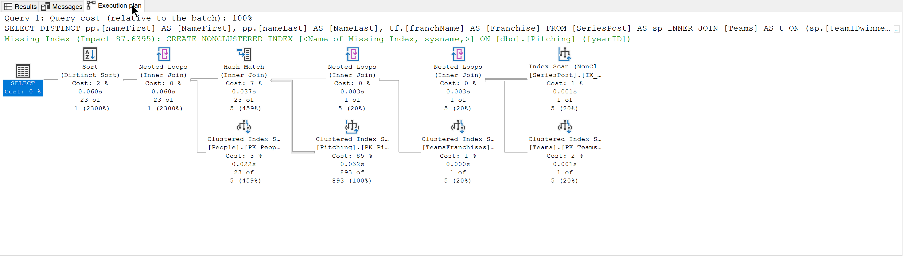
SELECT DISTINCT pp.[nameFirst] AS [NameFirst], pp.[nameLast] AS [NameLast], tf.[franchName] AS [Franchise]
FROM [SeriesPost] AS sp
INNER JOIN [Teams] AS t
ON (sp.[teamIDwinner] = t.[teamID]) AND (sp.[lgIDwinner] = t.[lgID]) AND (sp.[yearID] = t.[yearID])
INNER JOIN [TeamsFranchises] AS tf
ON t.[franchID] = tf.[franchID]
INNER JOIN [Pitching] AS p
ON (t.[teamID] = p.[teamID]) AND (t.[lgID] = p.[lgID]) AND (t.[yearID] = p.[yearID])
INNER JOIN [People] AS pp
ON p.[playerID] = pp.[playerID]
WHERE (sp.[round] = 'WS') AND (sp.[yearID] = 2018)

Slide 32


We need to go back to EF Core for a Minute

Slide 33
Query Tags
using var context = new BloggingContext();
// Fetch Blogs with a query tag
var blogs = await context.Blogs
.TagWith("Getting all blogs for dashboard")
.Where(b => b.IsActive)
.ToListAsync();
foreach (var blog in blogs)
{
Console.WriteLine($"Blog: {blog.Name}");
}

Slide 34
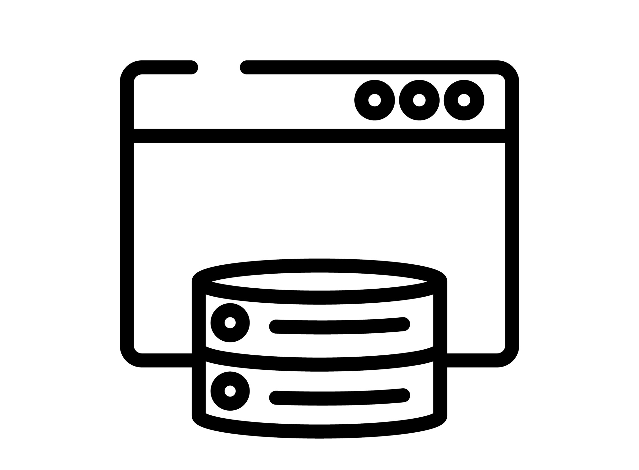
CACHING
Response Caching
In-Memory Caching
Distributed Caching

Slide 35
RESPONSE CACHING
Directs Caching on the consumer side
HTTP 1.1 Caching specification
Install the NuGet package:
Microsoft.Extensions.Caching.Abstractions
At start up add to Services:
services.AddResponseCaching();

Slide 36
RESPONSE CACHING
Attribute on Controller or Action
[ResponseCache(Duration = 60)]
Response Header:
Cache-Control: public,max-age=60
[ResponseCache(Location = ResponseCacheLocation.None, NoStore = true)]
Response Header:
Cache-Control: no-store,no-cache
Pragma: no-cache

Slide 37
IN-MEMORY CACHING
Install the NuGet package:
Microsoft.Extensions.Caching.Abstractions
At start up add to Services:
services.AddMemoryCache();

Slide 38
IN-MEMORY CACHING
var cache = services.GetService<IMemoryCache>();
cache.Set("key", "value", TimeSpan.FromMinutes(10));
var value = cache.Get<string>("key");

Slide 39
OUTPUT CACHING
services.AddOutputCache(options => { options.AddBasePolicy(builder => builder.Expire(TimeSpan.FromSeconds(10))); options.AddPolicy("Expire20", builder => builder.Expire(TimeSpan.FromSeconds(20))); options.AddPolicy("Expire30", builder => builder.Expire(TimeSpan.FromSeconds(30))); });
[HttpGet] [OutputCache] [Produces(typeof(List<AlbumApiModel>))] public async Task<ActionResult<List<AlbumApiModel>>> Get()

Slide 40
OUTPUT CACHING RULES
Only HTTP 200 responses are cached.
Only HTTP GET or HEAD requests are cached.
Responses that set cookies aren't cached.
Responses to authenticated requests aren't cached.

Slide 41
DISTRIBUTED CACHING
var cache = services.GetService<IDistributedCache>(); cache.SetString("key", "value");
var value = cache.GetString("key");

Slide 42
DISTRIBUTED CACHING
Local Redis Cache
SQL Server Cache
Azure Redis Cache
Amazon ElastiCache
Google Cloud Memcache

Slide 43

http://learn.microsoft.com/en-us/ef/core/
devblogs.microsoft.com/dotnet/tag/entity-framework/
https://www.youtube.com/@dotnet
Entity Framework Core
OTHER
RESOURCES
https://github.com/dotnet/efcore

Slide 44

Questions?
Turbo Charging EF Core

Slide 45

THANK YOU
https://github.com/cwoodruff/EFCorePerfDemos

